Slide 1
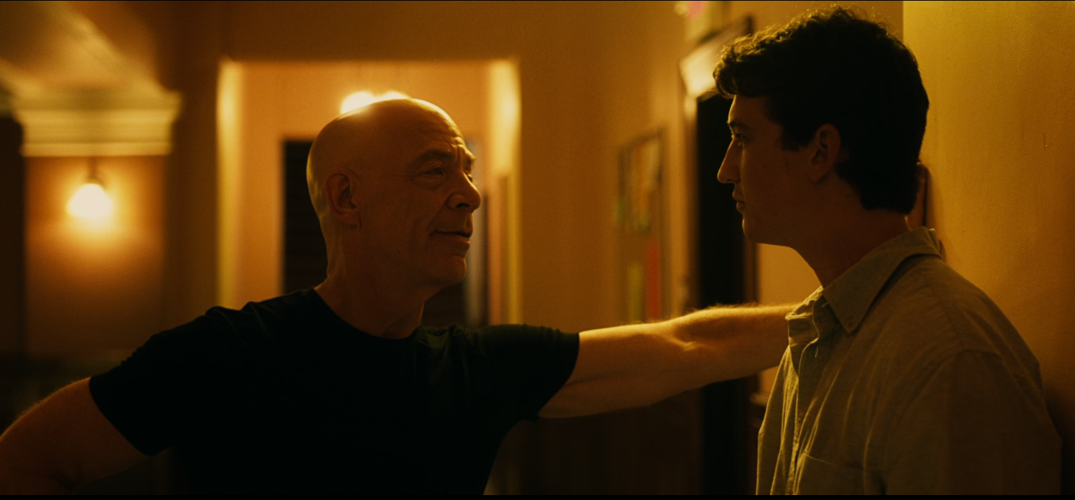
You’re here for a reason. You believe that right?
Noise: Body Language
Jazz Music
Consequences of underperforming
Yeah
Setting:
Jazz institute
Hallway outside of class.
Highly Regarded teacher
Optimistic and arrogant student.
Message
Face to Face Channel
Feedback
Say it.
I’m here for a reason.
Terrence Fletcher
Andrew Neiman

Slide 2
Communication Model Analysis
I chose to analyze a scene from one of my favorite movies, Whiplash. Terrence Fletcher and Andrew Neiman are communicating during a break of their first class together. The message is Terrence trying to tell Andrew that he’s here in this school and in his class for a reason. Andrew’s feedback is an unsure and nervous, “yeah.” In addition, Terrence wants to reinforce this point to Andrew by making him express it himself. This communication uses the verbal face to face channel, and there are several examples of noise and context in this model.
The physical noise the background Jazz Music. Physiological noise is Terrence’s imposing body language over Andrew. Psychologically, Andrew is nervous and scared having just witnessed the abuse of another student, but also has dreams of greatness. The physical setting is the Jazz institute both of them are in, and the hallway that is just outside of their classroom. The social and relational context is between a highly regarded and strict teacher, and an optimistic and slightly arrogant student. I believe they both understood what each person was saying and communicated effectively. The belief that, “being here for a reason” was instilled in Andrew for better or for worse, and Terrence also recognized that he believed that. All of the context and noise involved feeds into what each person takes away from it. Terrence wishing to push Andrew forward and Andrew wanting to be pushed forward is something both people wanted and took away from the interaction.

